Slide 1
Archetypes

Slide 2
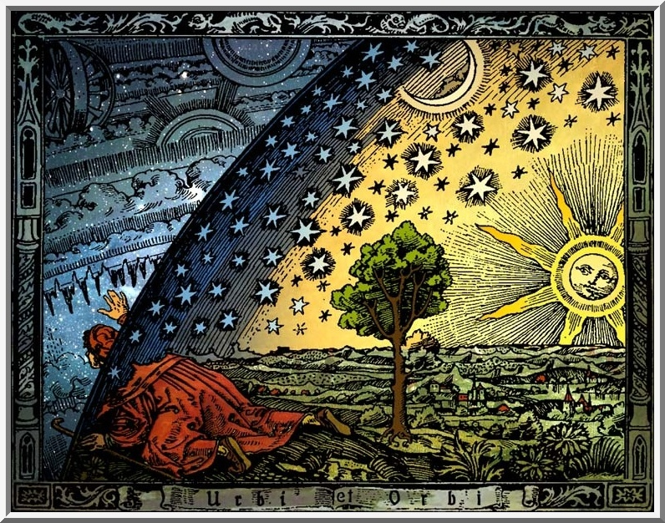
What Do Luke Skywalker, Simba, King Arthur, Moses, Katniss Everdeen, Harry Potter all have in common?

Slide 3
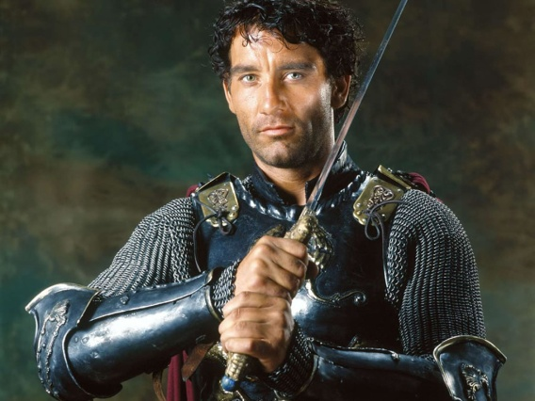
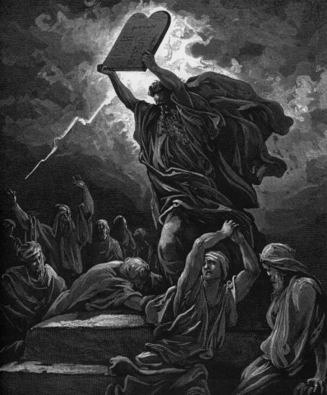
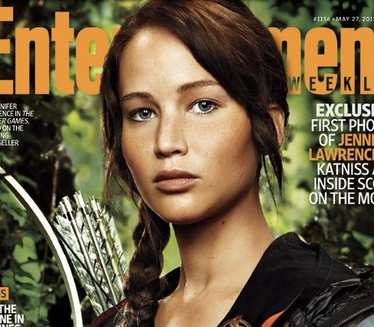
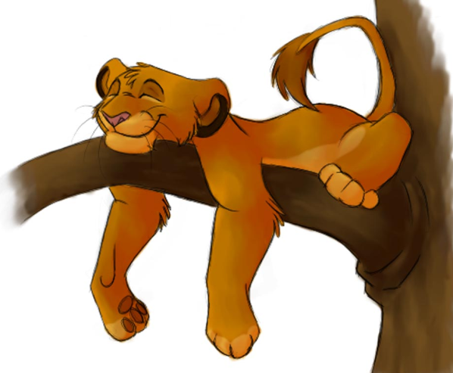
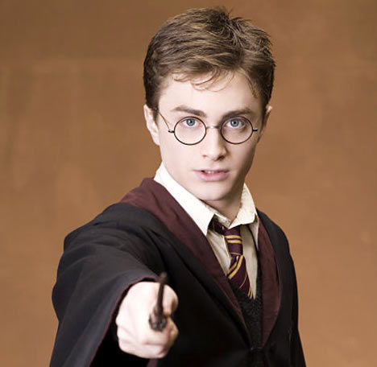
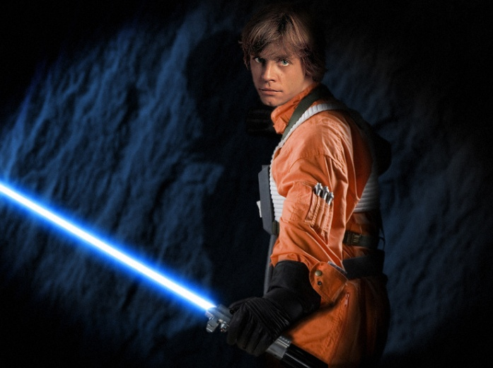
Answer:
They are All Archetypal Heroes

Slide 4
But what is an Archetype?

Slide 5
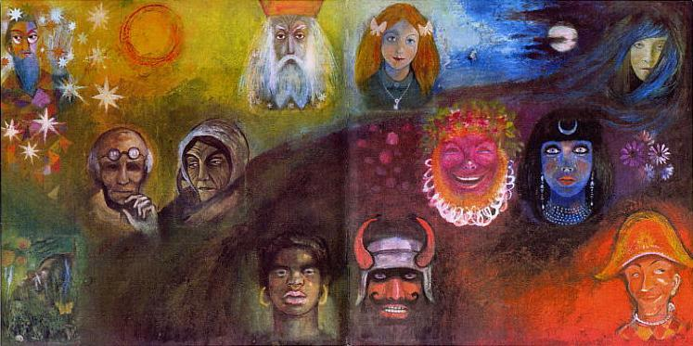
Archetype
A recurring pattern of images, situations, or symbols found in the mythology, religion, art, and dreams of cultures around the world.

Slide 6
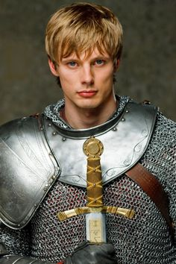
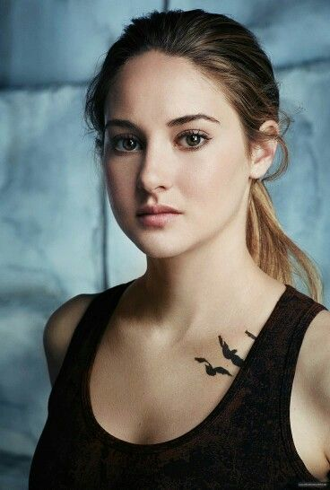
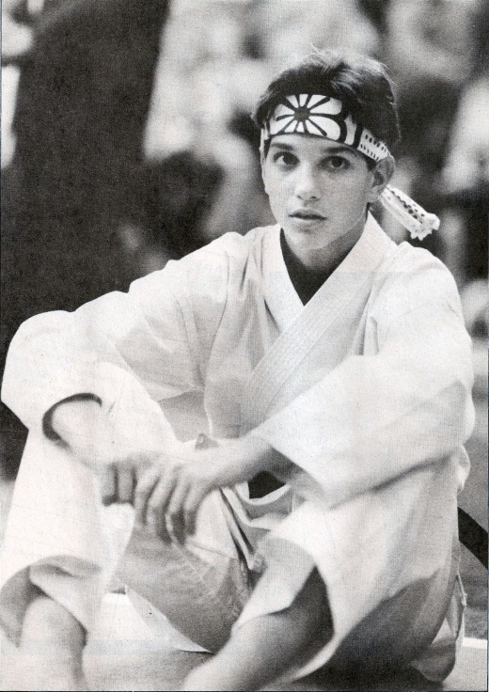
Character Archetypes
The Initiate
Young heroes or heroines who, prior to their quest, must endure some training and ceremony
They are usually innocent and often wear white
example: Young King Arthur, Daniel in The Karate Kid, Luke Skywalker, Triss from Divergent

Slide 7
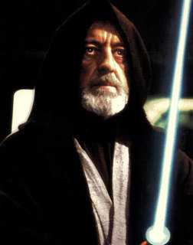
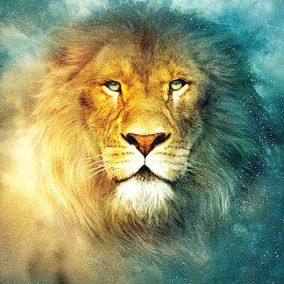
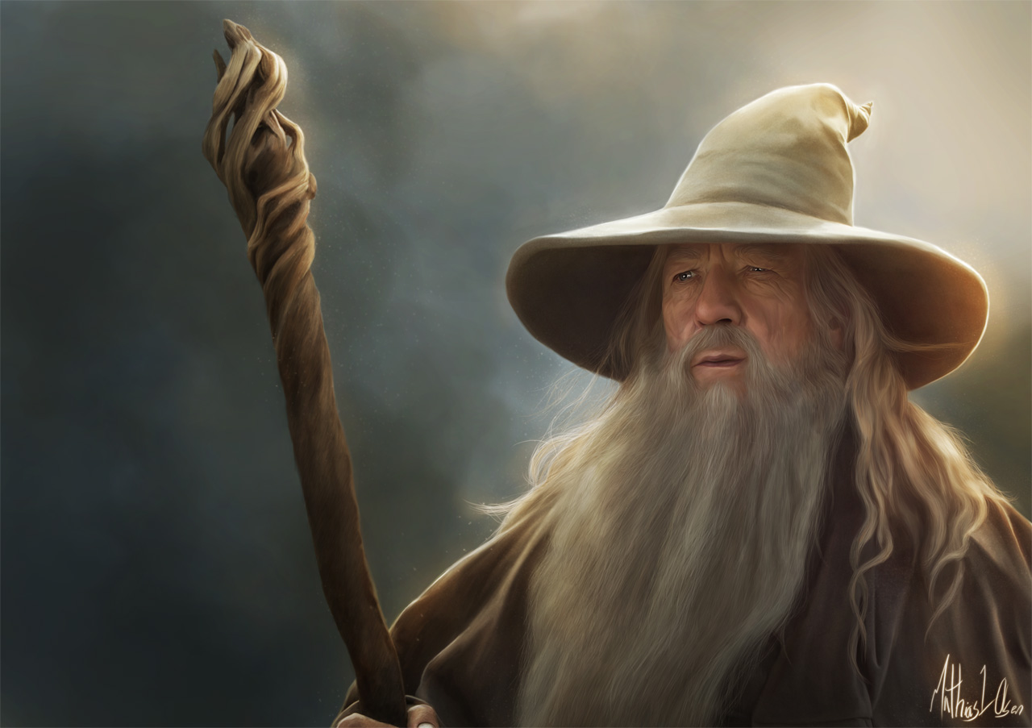
Character Archetypes
The Scapegoat
An animal or human who dies, usually to wipe out a sin that has been visited upon a community
This death makes that entity a more powerful force in the society that it lived
example: Obi Wan Kenobi, Gandalf, Aslan

Slide 8
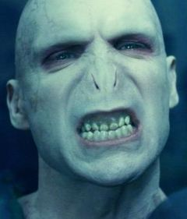
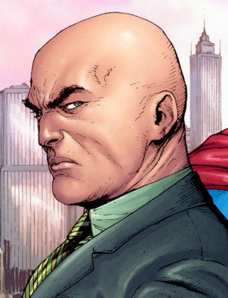
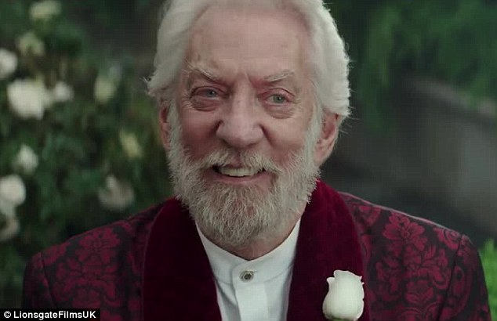
Character Archetypes
The Villain/Monster
a cruelly malicious person who is involved in or devoted to wickedness or crime
Example: Voldemort, Lex Luthor, President Snow

Slide 9
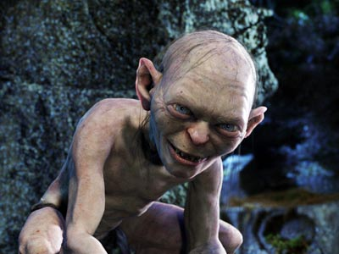
Character Archetypes
The Outcast
a figure who is banished from a social group for
some crime against his fellow man
he/she is usually destined to become a wanderer
example: Gollum, Quasimodo in Hunchback of Notre
Dame
Trickster
The best way to view a trickster is by his personality.
He is admired and loved by the audience for his charming nature.
He is represented as thievish, deceitful, and funny.

Slide 10
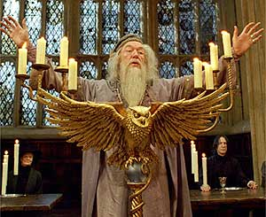
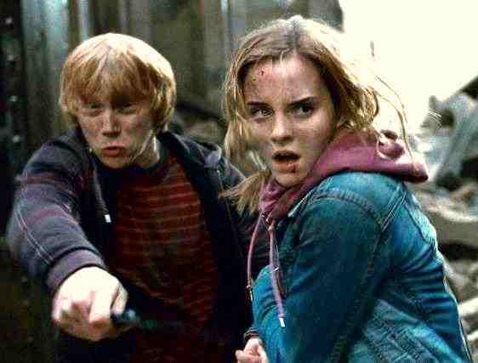
Character Archetypes
The Great Teacher/Mentor
wise old man or woman who represents knowledge,
wisdom, spirituality of soul, insight and protects or helps
the main character when he or she faces challenges
Example: Merlin, Dumbledore
The Loyal Retainer (“Sidekicks”)
The Retainer's duty is to reflect the nobility and
power of the hero
Example: Ron & Hermoine, Robin,
Robin Hood’s Merry Men

Slide 11
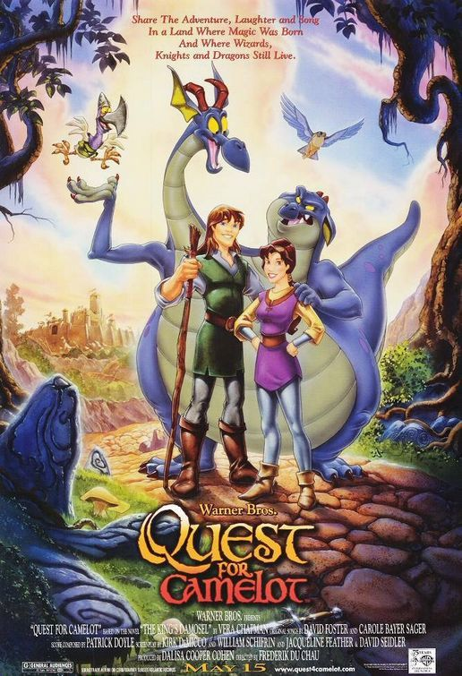
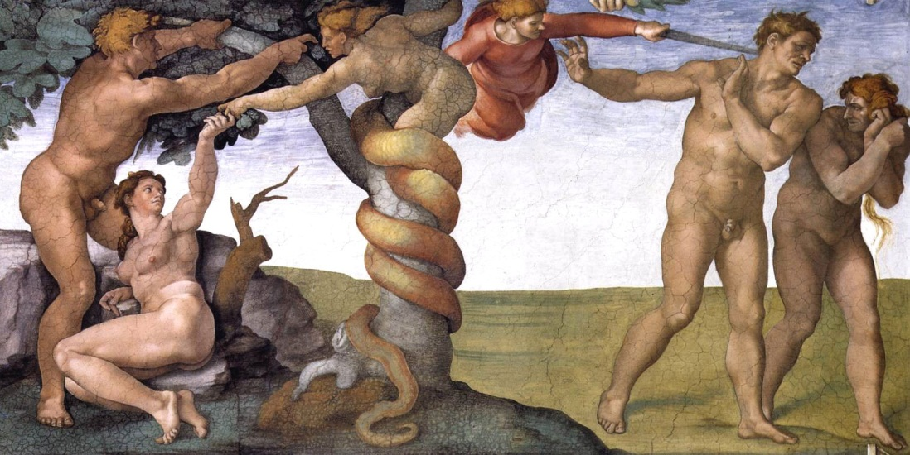
Situational Archetypes
The Quest
The search for someone or some object (talisman)
which, when found and brought back, will restore
fertility and life to a wasted land
The desolation of the land mirrors the leader’s illness
and disability
Example: The Holy Grail, The Lion King
The Fall
A descent from a higher to a lower state of being,
involving loss of innocence
Example: Adam & Eve, Lancelot & Guinevere

Slide 12
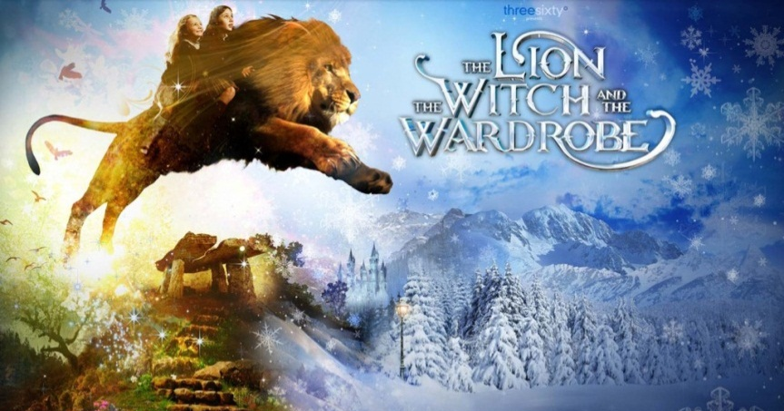
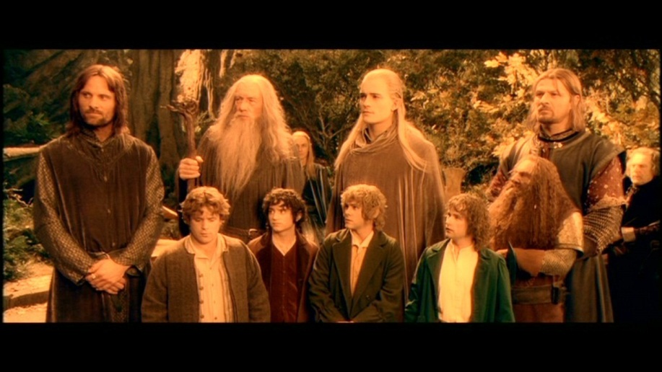
Situational Archetypes
Death and Rebirth
The parallel between the cycle of nature and the cycle of life Morning and springtime represent birth, youth, or rebirth
Evening and winter suggest old age and death
Most common of all situational archetypes?
Example: The Lion, The Witch, and the Wardrobe
The Battle between Good and Evil
Battle between two primal forces
Mankind shows eternal optimism in the continual
portrayal of good triumphing over evil despite the
Odds
Example: Sauron vs. Middle Earth,
Harry Potter vs. Voldemort

Slide 13
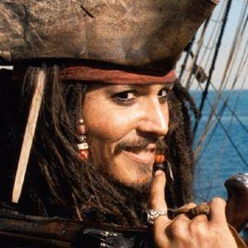
Archetypes
Remember not all characters possess one type of Archetypal characteristic. We are complex beings.

