Slide 1
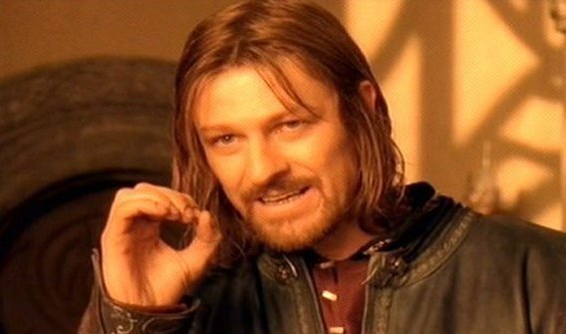
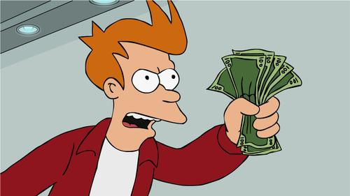
Making Meaning

Slide 2
Making Meaning
You are able to make meaning of symbols. You can interpret pictorial clues that are not necessarily realistic. This is called… Visual Literacy

Slide 3
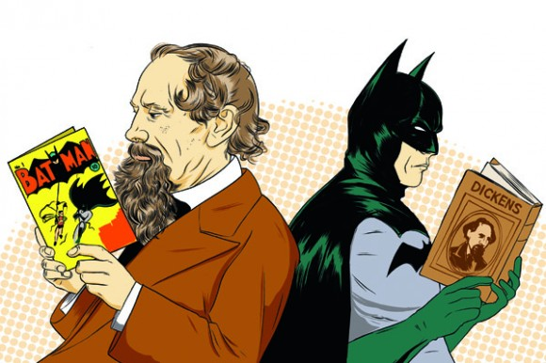
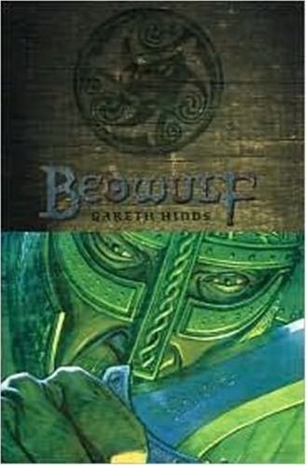
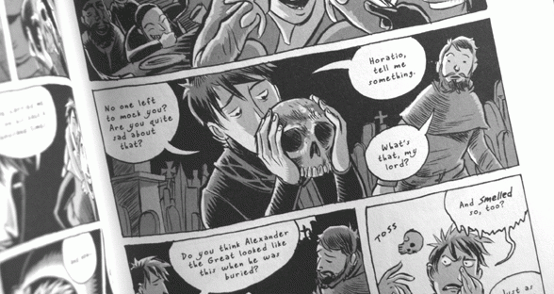
The Graphic Novel

Slide 4
Objectives: After today’s lesson you will be able to:
Create a comic that summarizes a text.
Determine theme.
Demonstrate knowledge of theme.
Cite textual evidence to support analysis of text.

Slide 5
Why? To be College and Career Ready you need to be able to:
Comprehend as well as critique.
Students are engaged and open-minded—but discerning—readers and listeners. They work diligently to understand precisely what an author or speaker is saying, but they also question an author’s or speaker’s assumptions and premises and assess the veracity of claims and the soundness of reasoning.
You demonstrate this skill by determining theme.

Slide 6
Why? To be College and Career Ready you need to be able to:
Value Evidence
Students cite specific evidence when offering an oral or written interpretation of a text. They use relevant evidence when supporting their own points in writing and speaking, making their reasoning clear to the reader or listener, and they constructively evaluate others’ use of evidence.
You demonstrate this skill by providing textual citations.

Slide 7
Why? To be College and Career Ready you need to be able to:
Come to understand other perspectives and cultures
Students appreciate that the twenty-first-century classroom and workplace are settings in which people from often widely divergent cultures and who represent diverse experiences and perspectives must learn and work together.
Students actively seek to understand other perspectives and cultures through reading and listening, and they are able to communicate effectively with people of varied backgrounds. They evaluate other points of view critically and constructively.
Your analysis, study, and interpretation of Beowulf allows you to develop this valuable skill.

Slide 8
After this lesson, you can add these skills to your Resume:
College and Workplace skills I hold:
I can comprehend as well as critique.
I value evidence.
I value and learn other perspectives and cultures.
http://www.corestandards.org/ELA-Literacy/introduction/students-who-are-college-and-career-ready-in-reading-writing-speaking-listening-language/

Slide 9
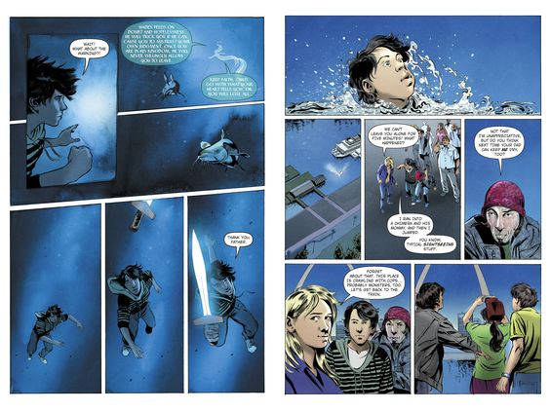
Makes a Graphic Novel?

Slide 10
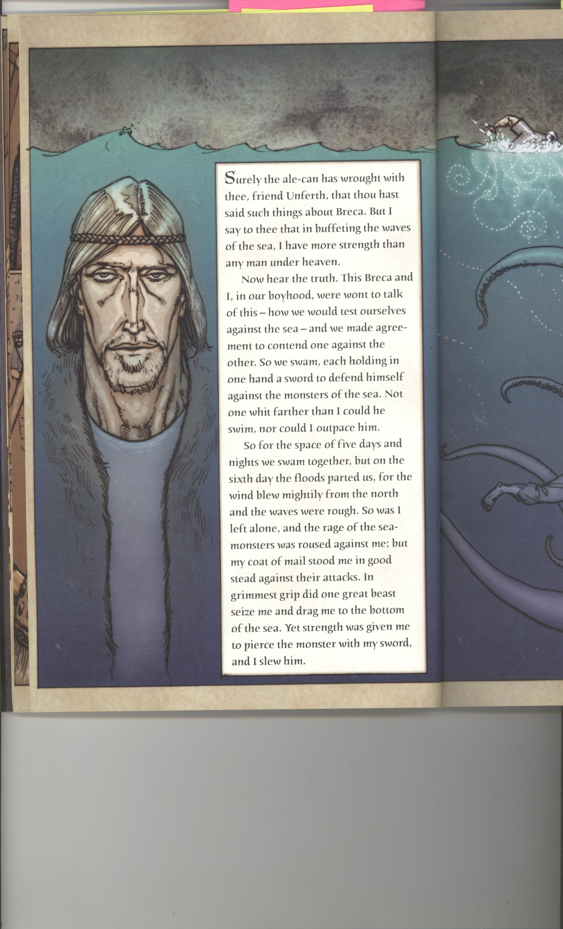
Panel - Panel refers to the framed image. It offers the reader a perspective or point of view on the subjects also known as the camera angle. Sometimes panels do not have borders, creating a unique effect where the subject seems to stand outside the storyline. Narration - Keep in mind that comic books allow the writer to show and tell at the same time, meaning there can be a combination of direct narration and indirect narration.

Slide 11
Speech bubble - These are frames around the characters’ language, a kind of ‘direct speech’, where the characters speak for themselves. If these appear as clouds, they represent the character’s thoughts. If they appear in jagged lines, the character is shouting. Emanata - This term refers to the teardrops, sweat drops, question marks, or motion lines that artists draw besides characters’ faces to portray emotion. Gutter - This refers to the space between panels. Readers tend to ‘fill in the blanks’ and imagine what happens between panels, a process known as ‘closure’.

Slide 12
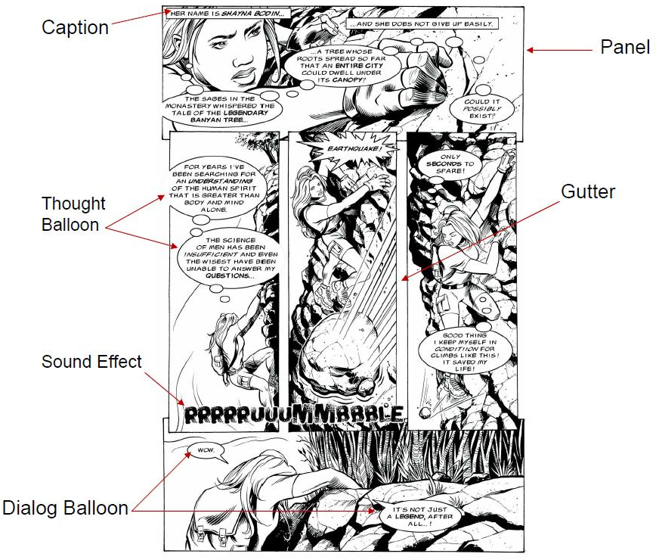

Slide 13
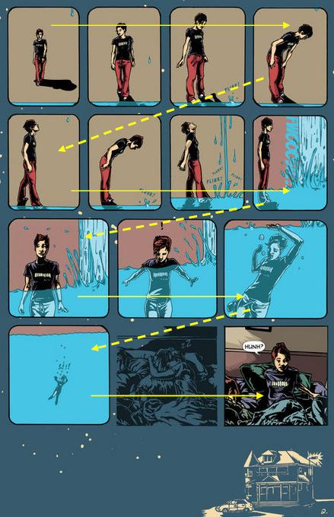
How to read a Graphic Novel
Read left to right, top to bottom follow the yellow arrows.
Sometimes it gets a bit more complicated if it doesn’t make sense one way, reread and try a different way.

Slide 14
What’s Your Focus
Foreground:
Your subject. Largest image, takes the focus.
Background:
Important information to have in the scene but it is not the focus of the scene.
Example: Setting and symbols

Slide 15
Quick and Powerful
Small panels read more quickly, which suggest action

Slide 16
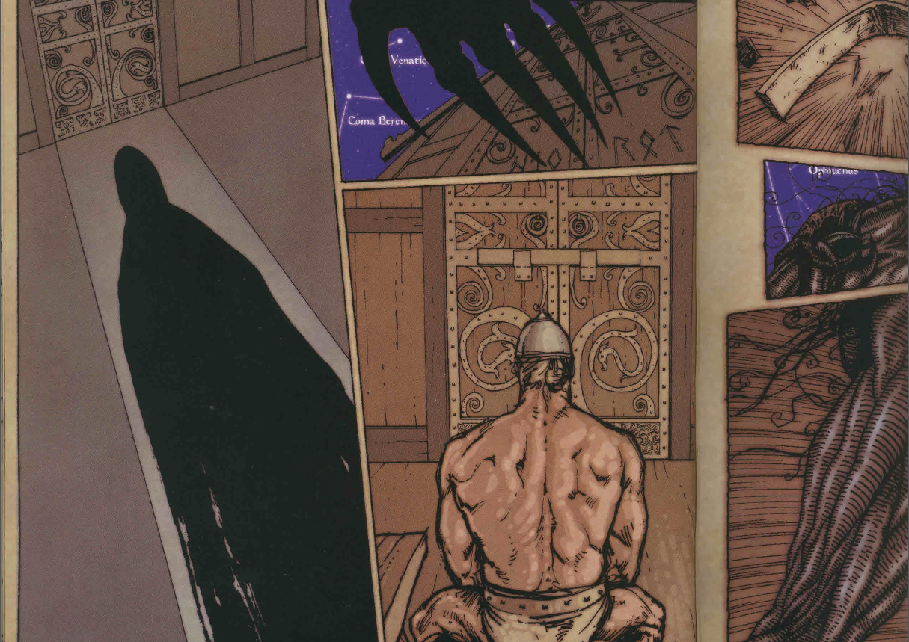
Slow and Suspenseful
Larger panels take longer to read, which suggests a pause and/or thoughtfulness Combinations create pacing

Slide 17
Not That Different After All...
Literary terms and skills still apply:
Metaphor, allusion, plot, setting, alliteration, motif, theme, tone, symbol
You LEARN sequencing, summarization, and theme analysis through the study and creation of comics and graphic novels.

Slide 18
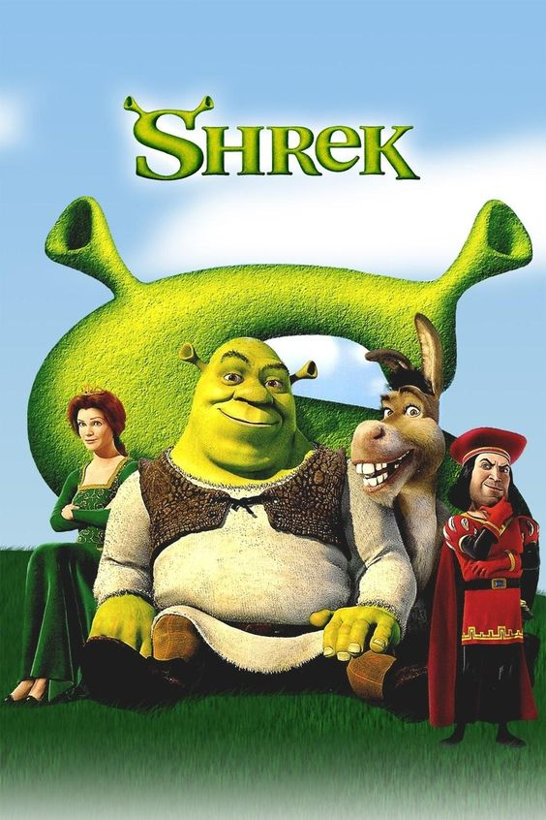
With a Partner:
Notes:
Shrek is grumpy, smelly and ugly ogre, living peacefully in a swamp. One night, he suddenly finds his land has been squatted by a mass of fairy-tale creatures (Pinocchio, the three little pigs, Peter Pan, Snow White, Cinderella, among others), who have been banished by the evil lord Farquaad. One of these is donkey (who just won't shut up). Accompanied by him, Shrek confronts Lord Farquaad, demanding his land back.
Farquaad does him a deal, telling him to rescue princess Fiona from a dragon-guarded castle, to get his swamp back. Shrek and Donkey go and rescue the Princess, narrowly avoiding being burned by the dragon. Fiona is disgruntled about being rescued by an ugly ogre, rather than Prince Charming. However, despite their differences, she and Shrek grow fond of each other.
On the second night of their return journey, Fiona hides in a windmill. Donkey finds her, and discovers that she's turned into an ogress. She explains that she's under a spell, which can only be broken by true love's first kiss. Shrek overhears part of this, but misunderstands and thinks she doesn't love him because he's ugly. Just as she decides to tell Shrek the truth, the sun rises and she becomes a beautiful princess again.
Lord Farquaad arrives and takes Fiona to his castle, and Shrek returns to his swamp. Both are miserable. Later, Shrek, Donkey and Dragon head to Farquaad's castle, to try to stop Fiona marrying him. When they arrive, the sun sets and Fiona becomes an ogress again. Farquaad doesn't want to marry her, and sets the guards on everybody, but Dragon comes to the rescue and eats Farquaad. Shrek and Fiona kiss. Therefore, Fiona stays ugly (in conformity with the spell: "you find true love's first kiss and then take love's true form"), and marries Shrek, and they live "ugly" ever after.

Slide 19
Let’s Practice!

Slide 20
